Slide 1
COS 212 Balancing a Binary Tree: AVL Trees

Slide 2
AVL Trees
DSW is a good algorithm to balance an unbalanced tree
Disadvantage?
What happens if we insert or delete a node?
DSW works on the global tree structure
We need an algorithm to adjust the tree locally when an item is added or removed such that the balance is maintained
AVL trees
Invented in 1962 by two Soviet scientists: Georgy Adelson-Velsky and Evgenii Landis
The sub-trees of every node differ in height by at most one
Every sub-tree is an AVL tree
3
E
G
1
7
A
F
C
H
2
6
10
B
D
D
Z
5

Slide 3
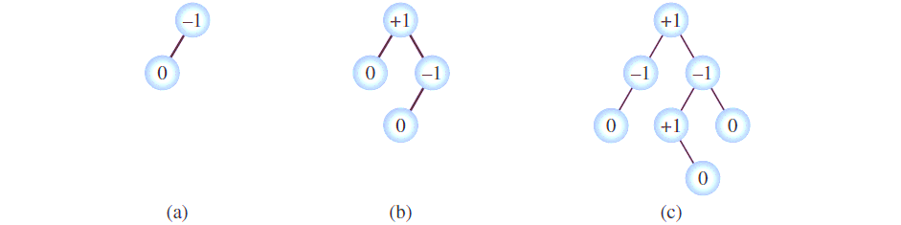
AVL Trees
AVL tree properties
The sub-trees of every node differ in height by at most one
Every sub-tree is an AVL tree
When an item is inserted or deleted, the above two properties must be preserved
How: every node has a “balance factor”: a number that indicates the difference between the height of the right and the left branch (bf = h(right) – h(left))
In a valid AVL tree, every node has a balance factor of -1, 0, or +1
When an item is inserted/deleted, the balance factors are updated, and if the balance is lost, the tree is rebalanced

Slide 4
AVL Trees: Insertion
How can a tree get out of balance?
Can a tree get out of balance if its left and right branches are of the same height?
Can a tree get out of balance if the left branch is longer than the right branch?
If the right branch is longer than the left branch?
G
C
H
G
G
C
H
C
I
B
D
H
J

Slide 5
AVL Trees: Insertion
If an insertion doesn’t unbalance the tree
Rebalancing is not required
We only need to update the balance factors for nodes moving back from the inserted node towards the root of the AVL tree
For example
-1
G
0
G
0
C
H
0
0
C
H
1
0
B
D
0
0
B
D
0
I
0

Slide 6
AVL Trees: Insertion
But, if an insertion unbalances the tree
We need to update the balance factors for nodes moving back from the inserted node towards the root of the AVL tree
We also need to rebalance the tree

Slide 7
AVL Trees: Insertion
Cases 1 & 4 mirror each other
Cases 2 & 3 mirror each other
Four cases producing an unbalanced tree:
Insert into the left subtree of the left child of n
Insert into the right subtree of the left child of n
Insert into the left subtree of the right child of n
Insert into the right subtree of the right child of n
1
3
G
2
C
4
G
C
C
H
B
I
C
H
B
I
B
D
H
J
B
D
H
J
A
D
E
Z

Slide 8
AVL Trees: Insertion
Let’s consider the two basic cases:
Insert into the left subtree of the left child of n (inserting on the “outside”)
Insert into the right subtree of the left child of n (inserting on the “inside”)
1
2
G
G
C
H
C
H
B
D
B
D
A
E

Slide 9
AVL Trees: Insertion
Case 1: Insert into the left subtree of the left child of n
Rebalance tree: One right rotation about unbalanced node
-2
G
0
C
-1
C
H
Rotate C around G
-1
B
G
0
-1
B
D
0
A
D
H
0
A

Slide 10
AVL Trees: Insertion
Case 2: Insert into the right subtree of the left child of n
Rebalance tree: One right rotation about unbalanced node?
-2
G
C
1
C
H
Rotate C around G
B
G
B
D
1
D
H
☹
E
0
E

Slide 11
AVL Trees: Insertion
Case 2:
First, transform Case 2 into Case 1 (left rotation about the left child)
Now, rebalance tree by a right rotation about unbalanced node!
We performed a left rotation first, then a right rotation
Sometimes, this AVL operation is referred to as a double rotation
Rotate D around C
Rotate D around G
-2
G
-2
G
0
D
1
C
H
-1
D
H
-1
C
G
0
B
D
1
-1
C
E
0
B
E
H
0
E
0
B

Slide 12
AVL Trees: Insertion
Four cases:
Right rotation about n
Left rotation about n.left, then right rotation about n
Right rotation about n.right, then left rotation about n
Left rotation about n
1
3
G
2
C
4
G
C
C
H
B
I
C
H
B
I
B
D
H
J
B
D
H
J
A
D
E
Z

Slide 13
AVL Trees: Insertion
How are we going to code it?
Starting from the node at which an insert happened, backtrack towards the root, updating the balance factors
If a balance factor > 1 or < -1 is encountered for node n:
If negative: Left branch insert happened
Is the inserted value x > n.left?
TRUE: Insert in right sub-tree of left child
Do a double Left-Right rotation
FALSE: Insert in left sub-tree of left child
Do a single Right rotation
If positive: Right branch insert happened
Is the inserted value x < n.right?
TRUE: Insert in left sub-tree of right child
Do a double Right-Left rotation
FALSE: Insert in right sub-tree of right child
Do a single Left rotation
Stop after the first unbalanced node has been found
Note that no ancestor nodes of n need
to have their balance factors updated
3
-2
1
9
-1
2
6
10
?
-1
5
7
0
4

Slide 14
AVL Trees: Deletion
To delete a node from AVL tree, perform delete by copying
Replace the node with the rightmost node of its left subtree
Update balance factors
Start with the original parent of copied node and move to the root
In the example:
We are deleting node 3
Replace node 3 with node 2
Delete node 2
Update balance factors from the original parent of the deleted node (node 1) up to the root
What if the tree becomes unbalanced?
For every unbalanced node encountered on the path to the root, re-balance the tree using rotations
Several re-balancing operations may therefore be necessary, unlike for insertions
How do we know what rotations are needed?
Specific combination of the corresponding balance factors will give us a good idea
?
2
3
0
1
9
2
6
10
5
7

Slide 15
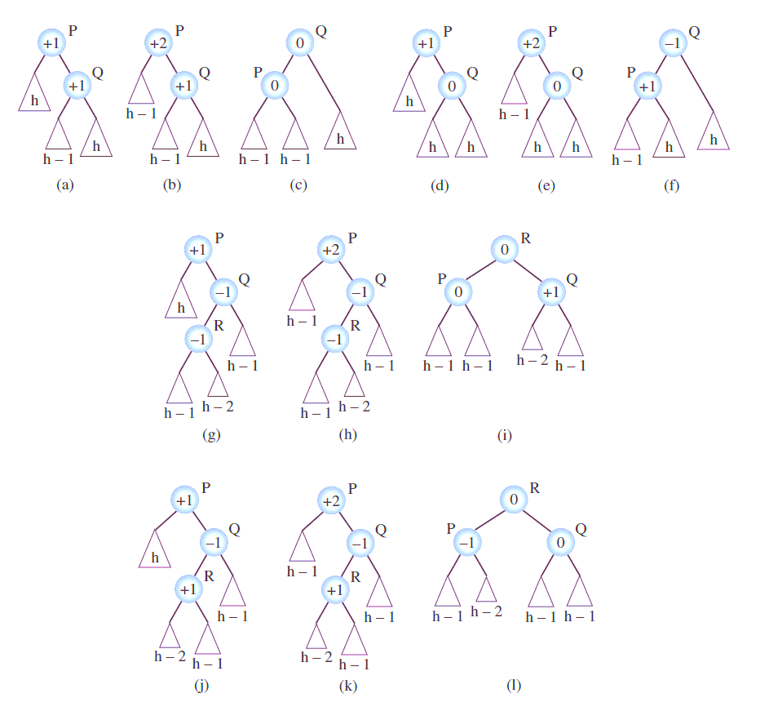
AVL Trees: Deletion
Case 1: Delete in the left branch causes left branch to become too small, and the right branch has +1 balance
One left rotation about unbalanced node re-balances tree:
1
C
2
C
0
D
B
D
1
D
1
C
E
0
E
E

Slide 16
AVL Trees: Deletion
Case 2: Delete in the left branch causes left branch to become too small, and the right branch has 0 balance
One left rotation about unbalanced node re-balances tree:
1
C
2
C
-1
E
B
E
0
E
0
1
C
F
D
F
D
F
D

Slide 17
AVL Trees: Deletion
Case 3: Delete in the left branch causes left branch to become too small, the right branch has -1 balance, and the left child of the right child also has -1 balance.
A double rotation is required:
Right rotation about right child of unbalanced node
Left rotation about unbalanced node
1
3
2
3
2
3
6
0
-1
-1
1
9
2
9
2
6
1
0
3
9
1
-1
-1
1
2
6
10
6
10
5
9
2
5
10
5
5
10

Slide 18
AVL Trees: Deletion
Case 4: Delete in the left branch causes left branch to become too small, the right branch has -1 balance, and the left child of the right child also has +1 balance.
A double rotation is required:
Right rotation about right child of unbalanced node
Left rotation about unbalanced node
1
3
2
3
2
3
6
0
-1
-1
1
9
2
9
2
6
2
-1
3
9
0
1
1
0
2
6
10
6
10
9
2
7
10
7
7
7
10

Slide 19
AVL Trees: Deletion
Cases 1 & 2 (root +2, right >= 0) require the same single rotation – do with a single if statement
Cases 3 & 4 (root +2, right < 0) require the same double rotation – do with a single if statement
Four more cases if the right branch becomes too short: mirror the 4 cases discussed
8 distinct cases to consider in total
Try it out as an exercise!

